Slide 1
DRS Drag Reduction System
Study and design and optimize a DRS for F1 cars
Course of Mechatronics Systems Simulation
Academic Year 2021-2022
Corradini Giacomo Student ID: 233256
Oselin Pierfrancesco Student ID: 229564
Serafini Daniele Student ID: 232273

Slide 2
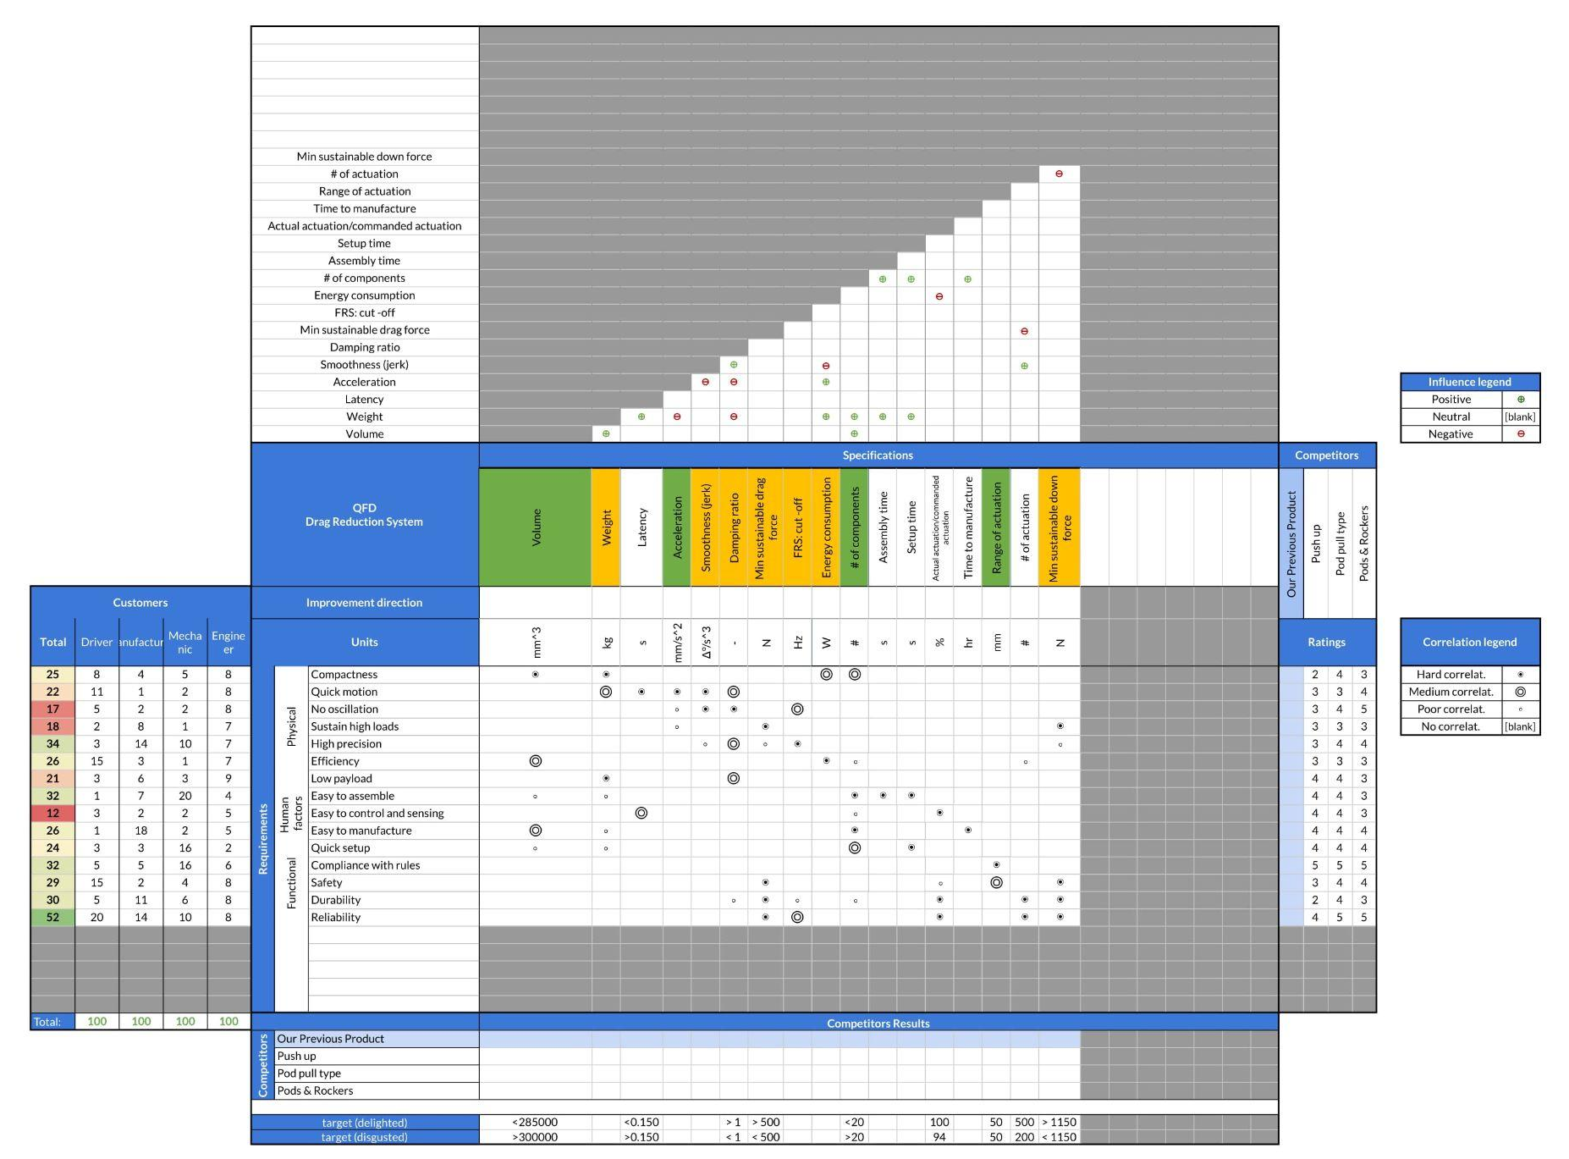
1 - QFD:
Quality
Function
Deployment
In order to better understand the problem we used the QFD.
QFD permits us to listen carefully the voice of the customer and then effectively responding to those needs and expectations

Slide 3
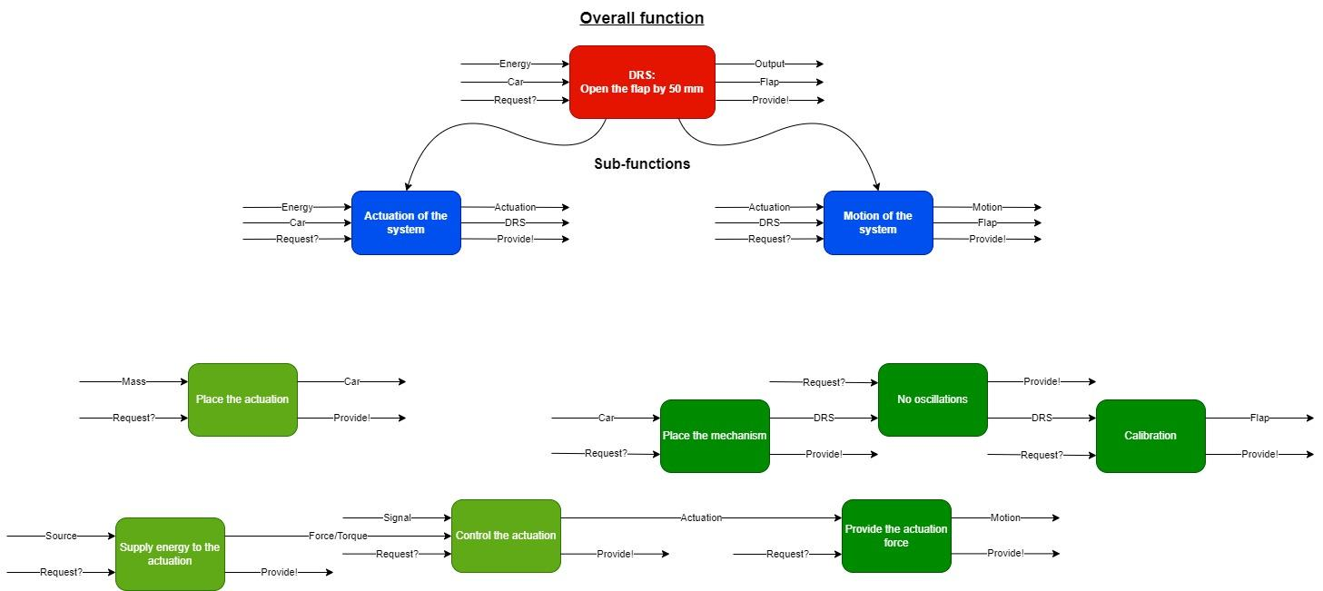
2 - Functional Decomposition
Functional decomposition splits a large complex task into smaller, simpler atomic functions, fostering a better understanding of the overall process.

Slide 4
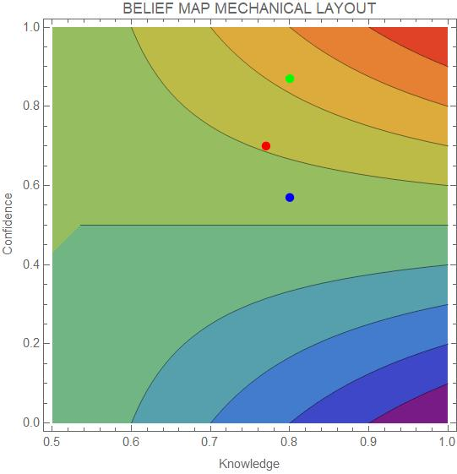
3 - Robust Decision Making
Decisions based on our level of confidence and knowledge
Below are some pros & cons:
Pods & Rocker mechanism
No Euler instability
Less vibrations
Customize profile of actuation
Aerodynamic influence
High number of constraints
Pod pull mechanism
No Euler instability
Less vibrations
Aerodynamic influence
Push up mechanism
Less aerodynamic influence
More vibrations
Euler instability

Slide 5
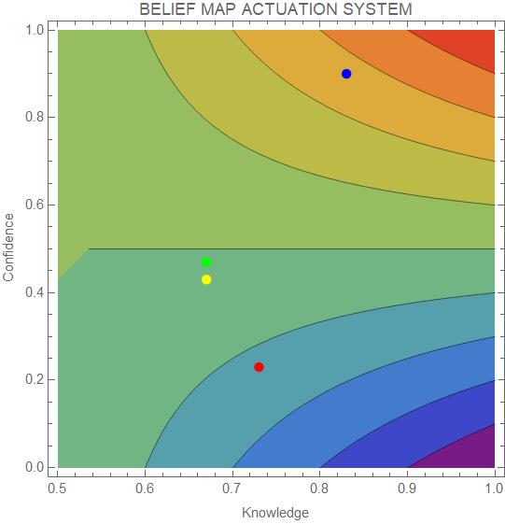
3 - Robust Decision Making
Decisions based on our level of confidence and knowledge.
Below are some pros & cons:
Electric motor
Quite energy required to work
Precise and accurate
Pneumatic actuator
Lack of precision and accuracy
Slow response
Hydraulic actuator
Precise and accurate
Low energy required to work
Electric actuator
Quite energy required to work
Precise and accurate

Slide 6
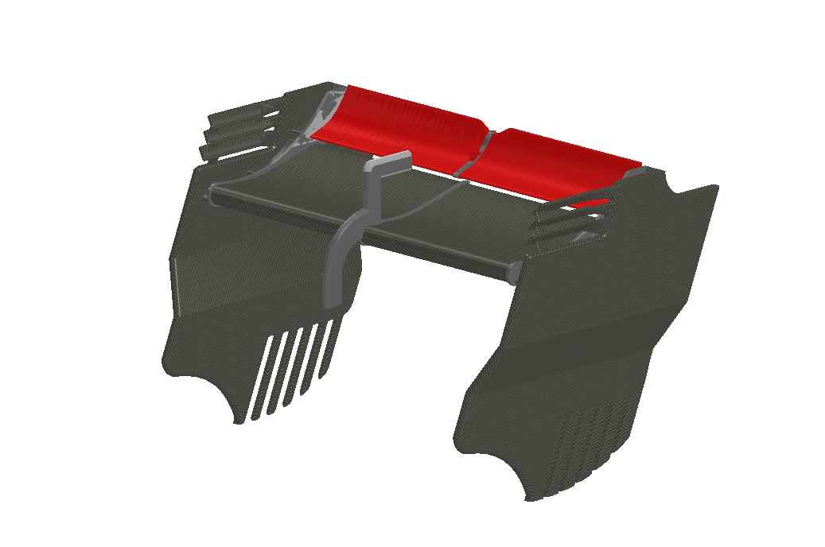
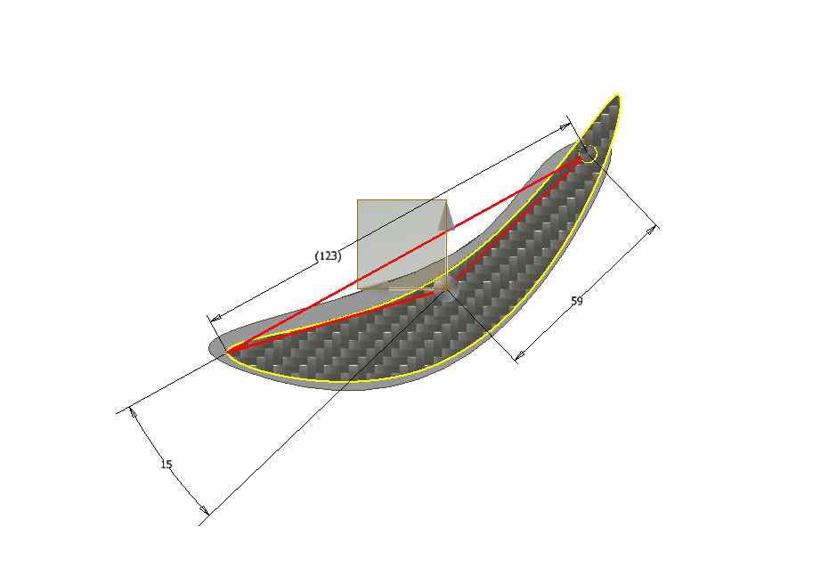
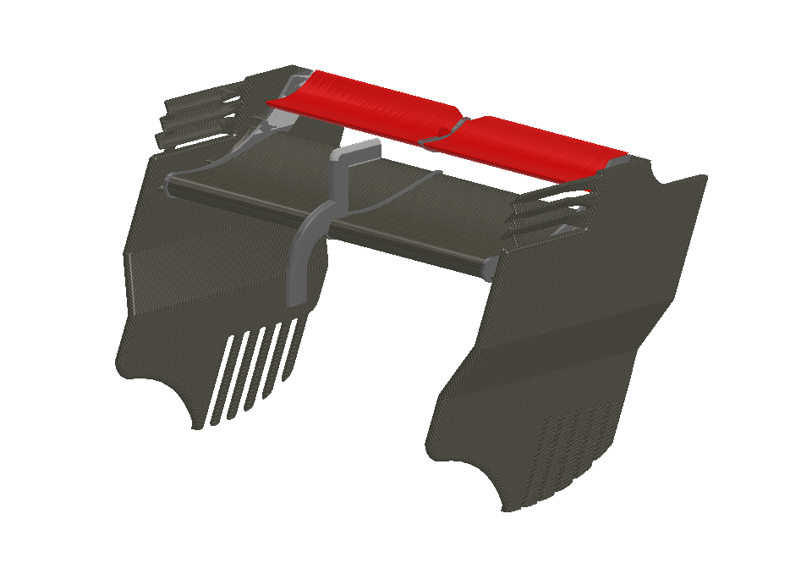
4 - Data
Rear wing 2017 Formula one car
In order to do a more realistic analysis we have considered a real rear wing of a formula one car. It is present in the website.

Slide 7
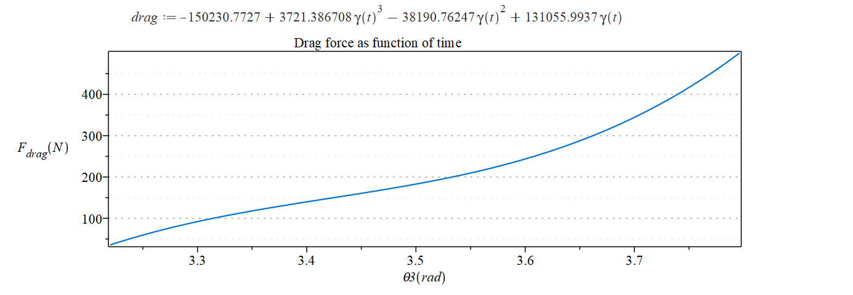
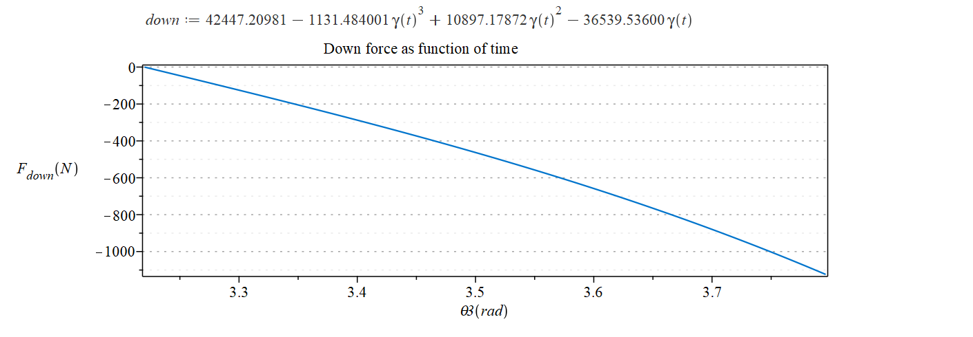
4 - Drag/Down force interpolation (from the paper)

Slide 8
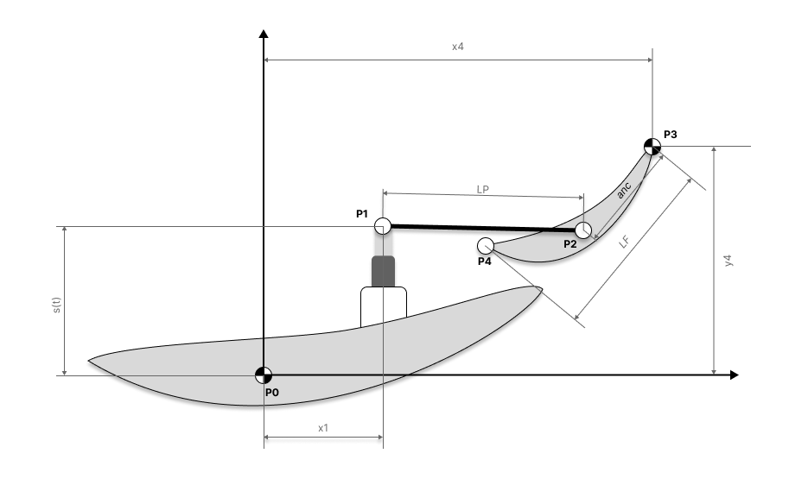
5 - Mechanism analysis
Push-up mechanism

Slide 9
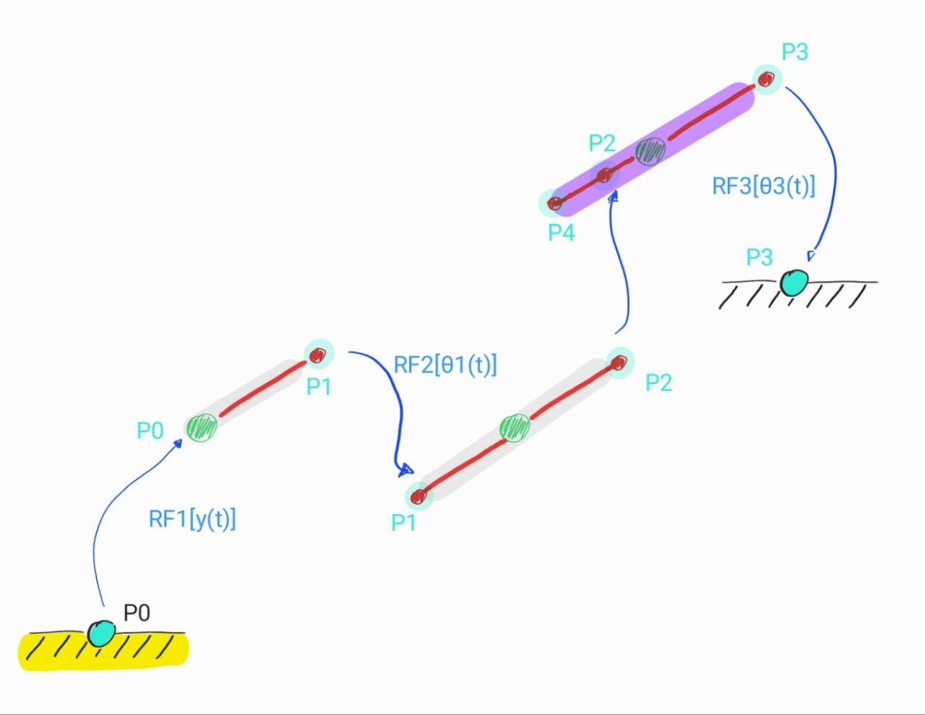
5 - Graph of the push up mechanism

Slide 10
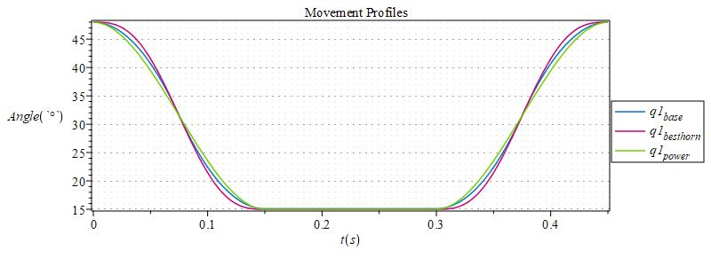
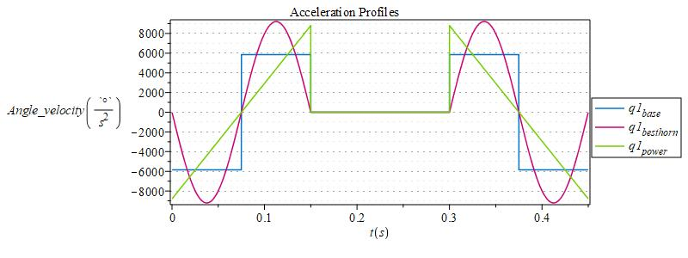
5 - Design specifications: smooth flap movement
Smooth transitioning
Forces’ jumps avoidance
Residual oscillations avoidance
Feasible actuation of the piston

Slide 11
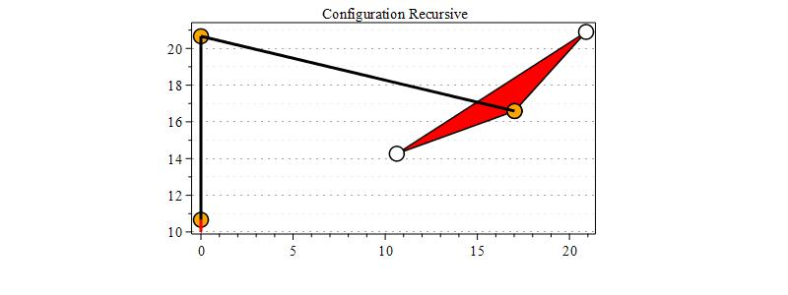
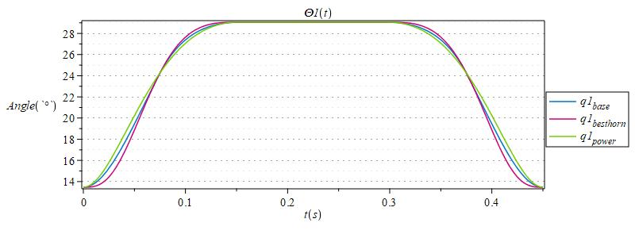
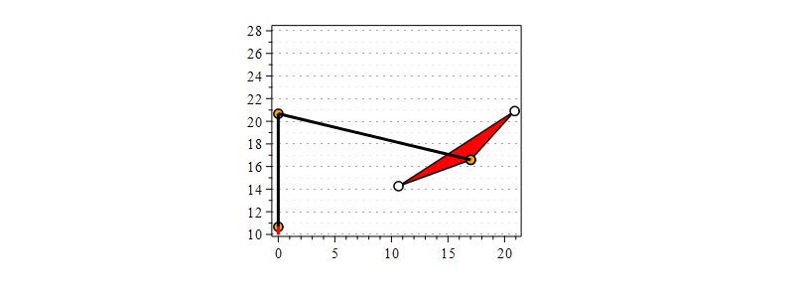
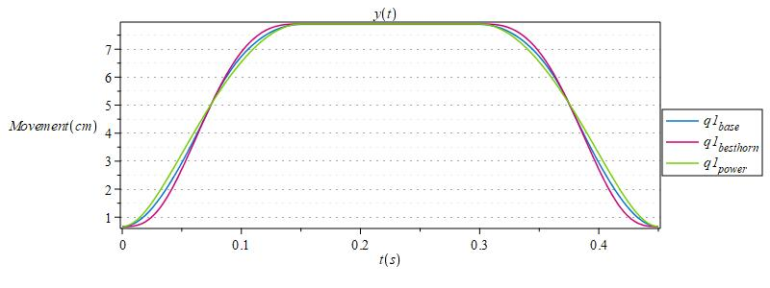
5 - Push-up Position analysis

Slide 12
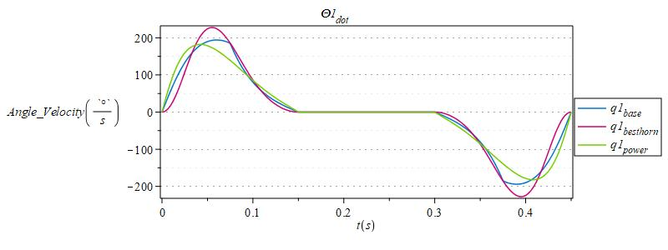
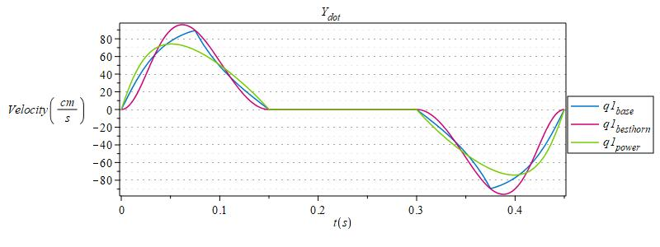
5 - Push-up Velocity analysis

Slide 13
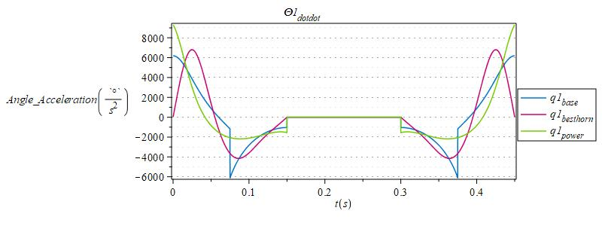
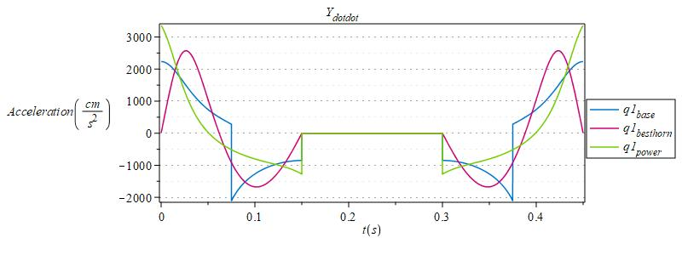
5 - Push-up Acceleration analysis

Slide 14
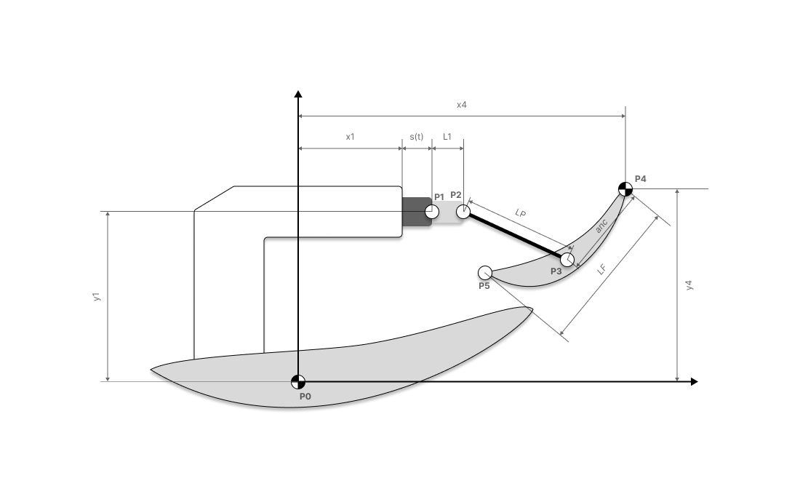
5 - Mechanism analysis
Pod-pull mechanism

Slide 15
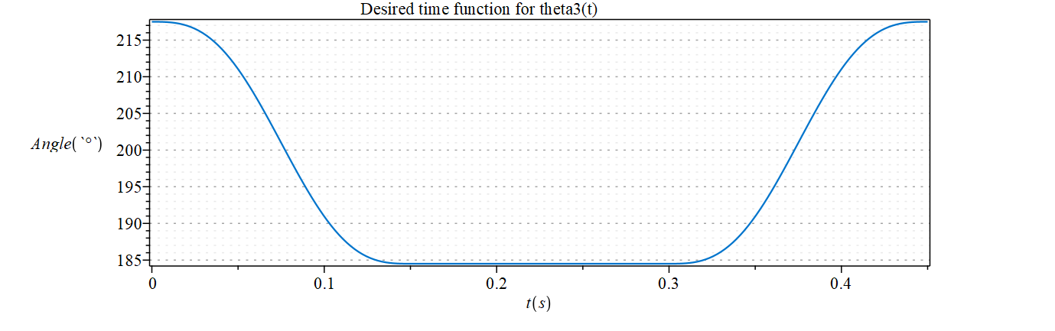
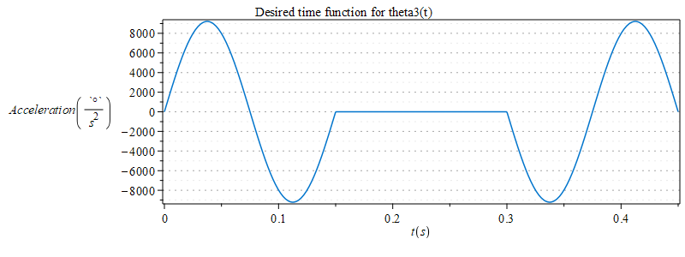
5 - From the design specifications: smooth flap movement

Slide 16
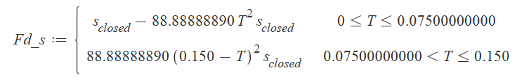
5 - Parameters optimization from kinematics
Desidered motion for θ3(t)
Motion for s(t)
Estimation of the error
(cost function)
Minimization through optimal parameters values
Desidered generic and smooth motion for s(t)

Slide 17
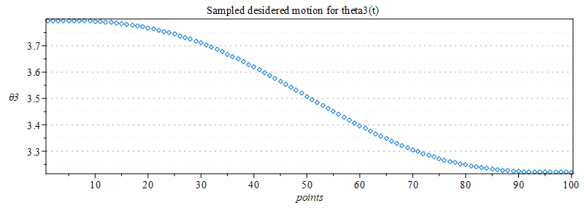
5 - Parameters optimization from kinematics

Slide 18
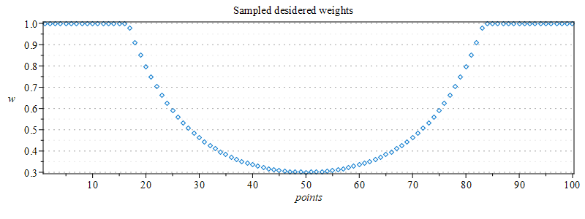
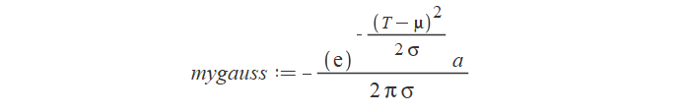
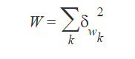
5 - Parameters optimization from kinematics

Slide 19
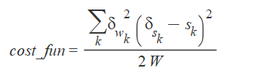
5 - Parameters optimization from kinematics
Parameters to be optimized: L1, LP, anc, x1, y1, s_{closed}

Slide 20
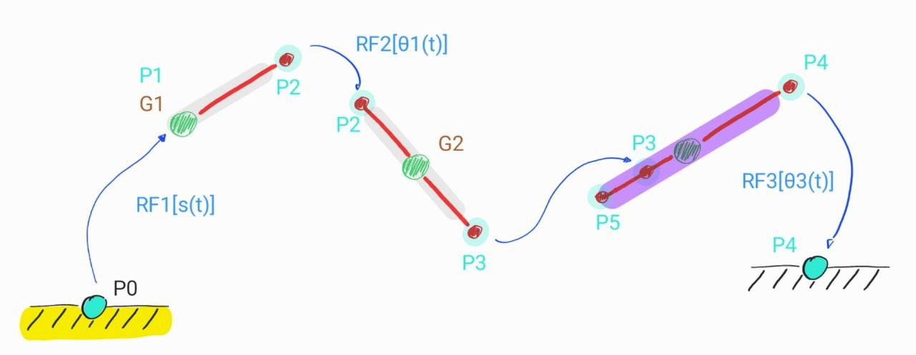
5 - Graph of the pod pull mechanism

Slide 21
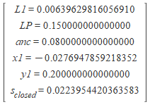
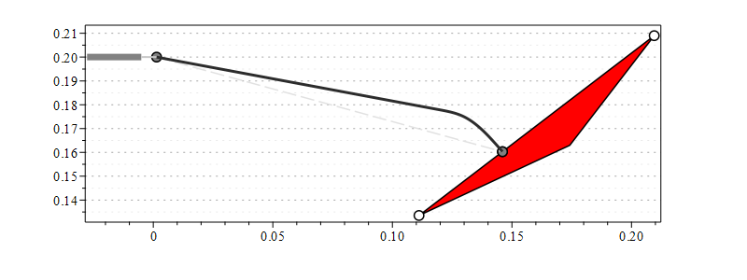
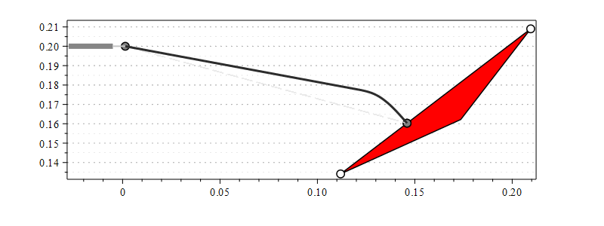
5 - Parameters optimization from kinematics

Slide 22
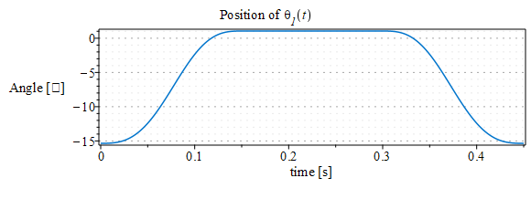
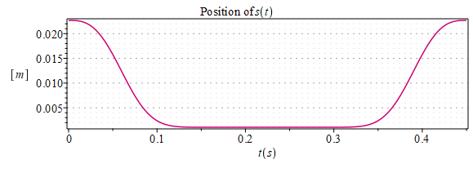
5 - Position, velocity, acceleration analysis

Slide 23
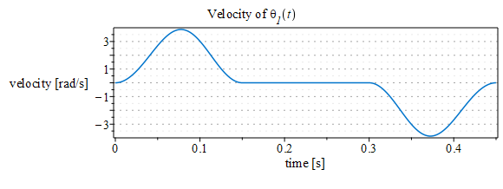
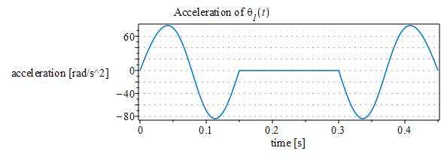
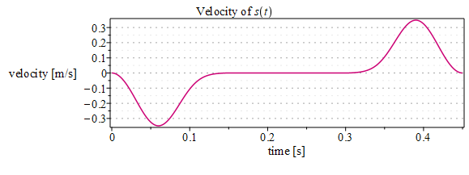
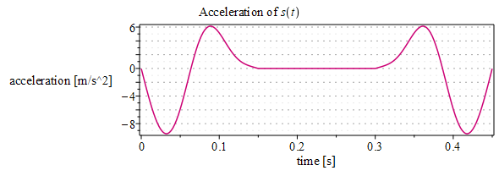
5 - Position, velocity, acceleration analysis

Slide 24
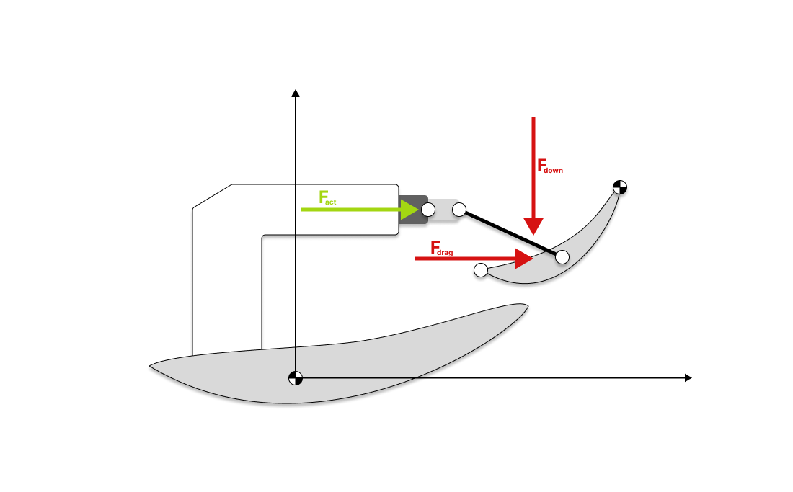
5 - Force definitions: we define the drag force and down force and we suppose that they are applied to the flap center of mass

Slide 25
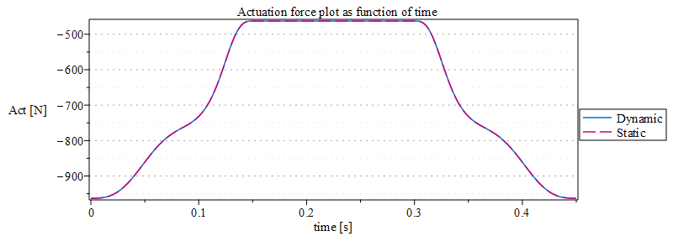
5 - Principle of virtual work

Slide 26
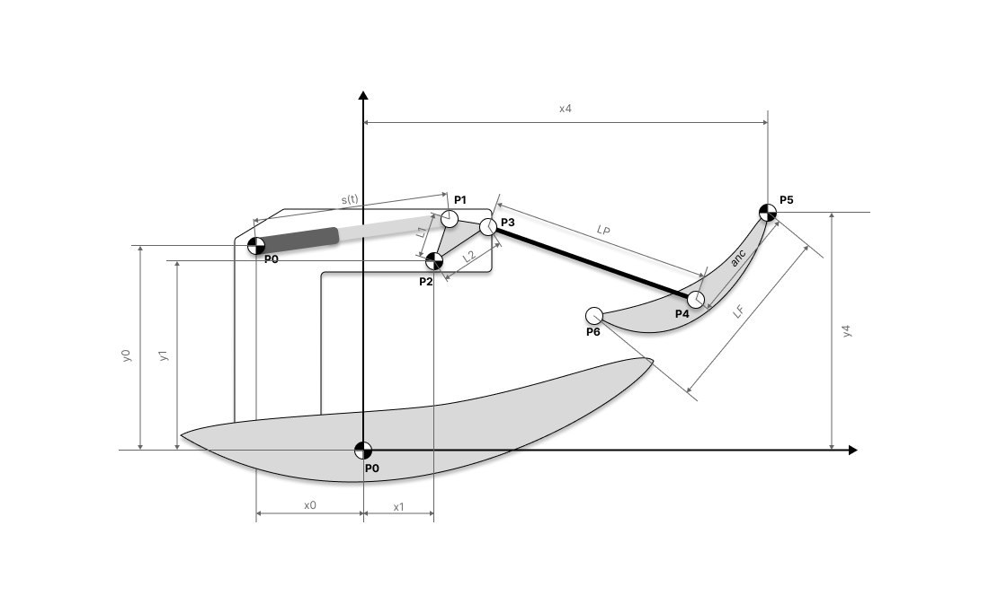
5 - Mechanism analysis
Pods and rockers mechanism

Slide 27
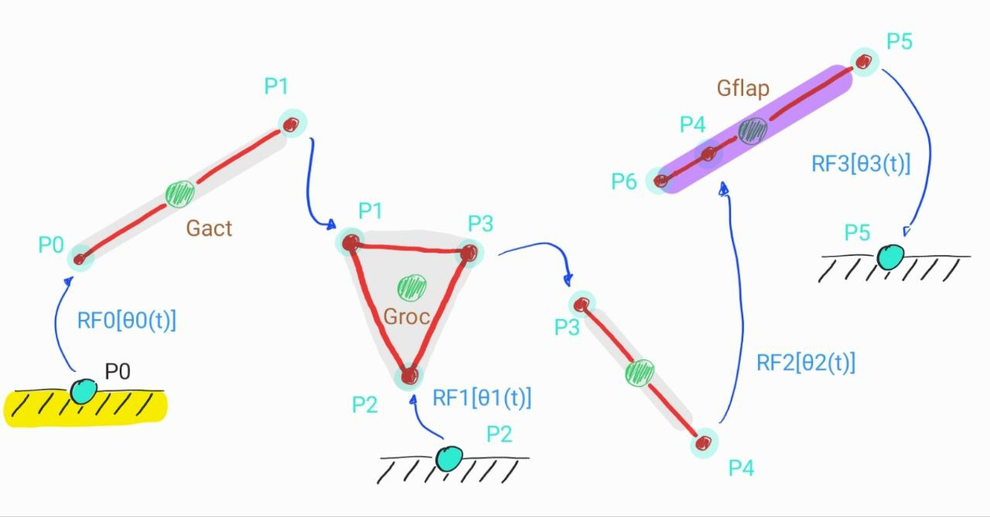
5 - Graph of the pods and rocker mechanism

Slide 28
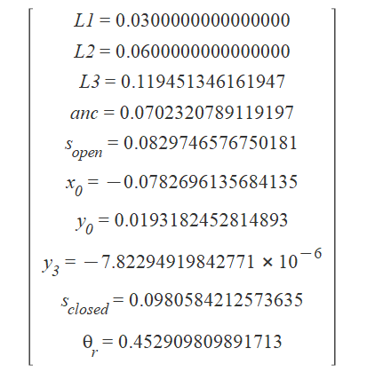
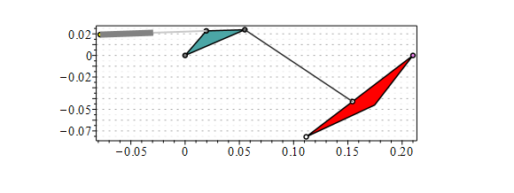
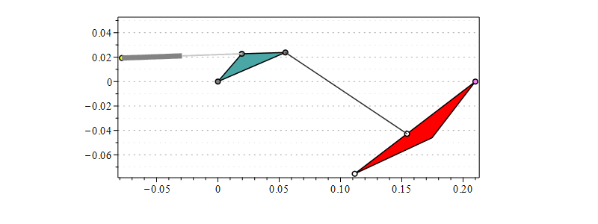
5 - Parameters optimization from kinematics

Slide 29
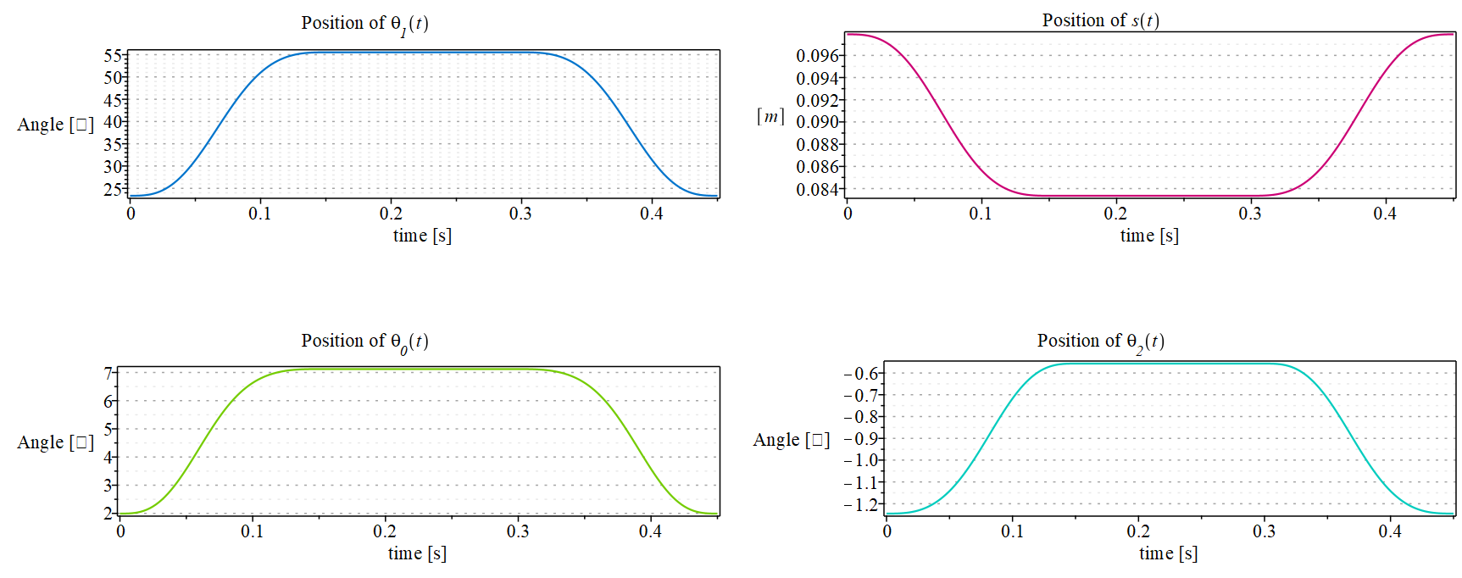
5 - Position analysis

Slide 30
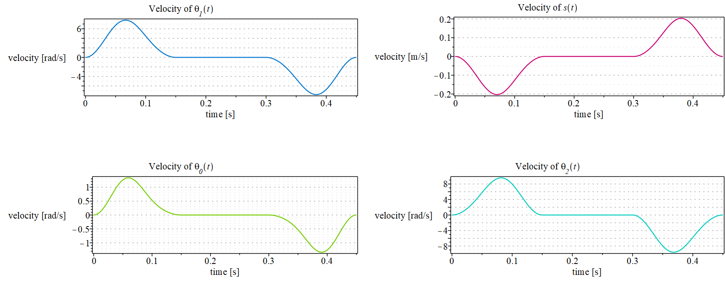
5 - Velocity analysis

Slide 31
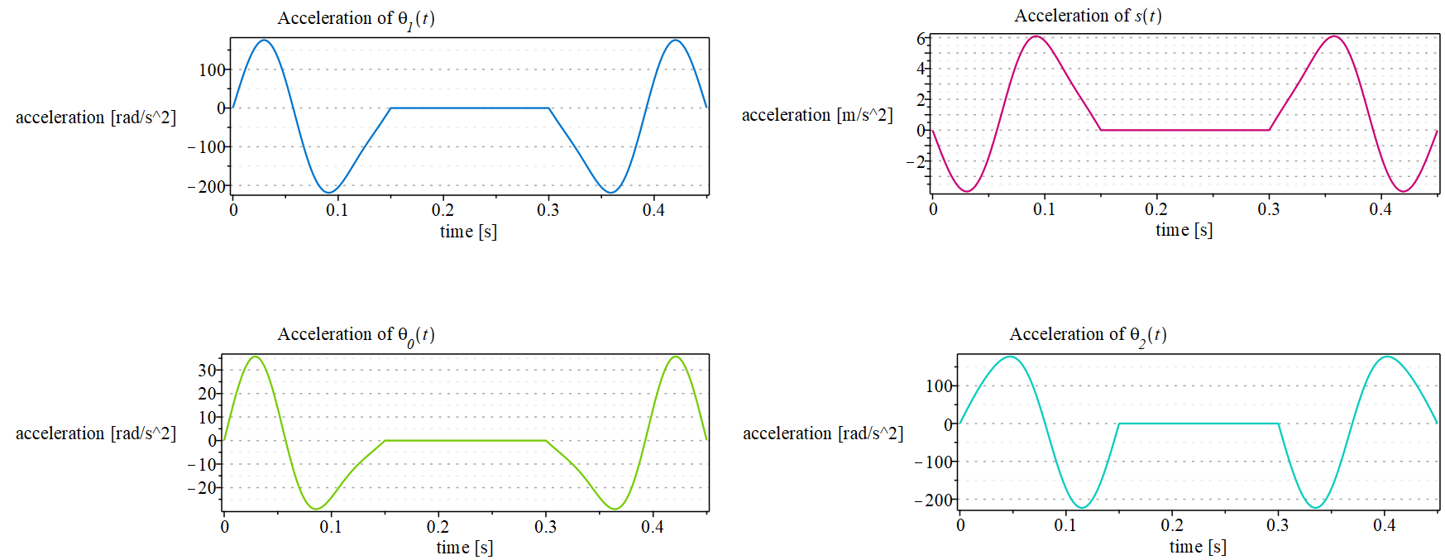
5 - Acceleration analysis

Slide 32

5 - Pods and rockers analysis
Force definitions: we define the drag force and down force and we suppose that they are applied to the flap center of mass

Slide 33

5 - Pods and rockers analysis
Dynamic analysis: Principle of virtual work

Slide 34

5 - Pod Pull analysis
Equation of motion, Newton-Euler formulation

Slide 35




5 - Reaction forces

Slide 36




5 - Reaction forces

Slide 37

5 - DAE solution
It is shown the plot of s(t) obtained from three different analysis

Slide 38

5 - Pod Pull analysis
Equation of motion, Lagrange formulation

Slide 39

5 - DAE solution
It is shown the plot of s(t) obtained from three different analysis

Slide 40

5 - Dynamic Parameters Optimization

Slide 41

5 - Pod Pull - inventor environment

Slide 42

6 - MapleSim analysis

Slide 43

6 - Main File

Slide 44

6 - Flap subfile

Slide 45

6 - Wing animation

Slide 46


Slide 47

6 - Wing forces

Slide 48

6 - Movements comparison

Slide 49

7 - Maple Hydraulics analysis

Slide 50

7 - Maple Hydraulics analysis
F_{act}

Slide 51

7 - Maple Hydraulics analysis

Slide 52

7 - Maple Hydraulics analysis

Slide 53

7 - Maple Hydraulics analysis
Operating Pressure - 207bar (3000psi)
Maximum RPM - 11,000
Displacement - 0 - 2.46cubic centimeters per Rev (0.15inch)
Max Flow Per Minute - 25.7L (6.8USG)
Dry Weight without customer specific mount flange - 1.18KG (2.6lbs)
Length without customer specific mount flange - 90mm - 57mmW - 80mmH
Materials - Customer specific mount flange - Titanium.
Main gold body - 7 Series Aluminium.
Swash plate piston control housing - Cast Aluminum.
Rear Outlet cap - Cast Stainless.
Internals - Steel/Forged steel.
https://www.f1technical.net/forum/viewtopic.php?t=28398

Slide 54


7 - Maple Hydraulics analysis
Gear Pumps - AP05

Slide 55

7 - MapleSim Hydraulics analysis, Hydraulic Circuit

Slide 56

7 - Hydraulic Main File

Slide 57

7 - Wing Movement

Slide 58

7 - Wing Forces

Slide 59

7 - Movements comparison

